Slide 1
Final Report

Slide 2
Industry Analysis
Generally educational services industry, especially truly helping customers
Identifying growth opportunities
PESTEL Analysis
SWOT Analysis
Competitor Analysis
Marketing ideas & strategies

Slide 3
Identifying Growth Opportunities
Key statistics (provided by Australian Bureau of Statistics)
Employment in Education and Training is projected to grow by 13.4% over the five years to November 2026
"The world-class Australian education sector is widely considered a vital resource to Australian society"
Business and Management is the most common field of study for non-school qualifications.

Slide 4
Identifying Growth Opportunities
For people in the workforce, provide access to...
Growth opportunities for Coachjable
Provide courses regarding management, starting a business & maintaining mental health
Attract coaches with more free time and high skill level to truly help customers
Segment the audience and provide tailored products & services to maximize values
Thriving education sector
Knowledge and working skills
Employment opportunities
Useful courses and programs
Foreseeable industry prospects
Promote individual developments to achieve dreams

Slide 5
PESTEL Analysis
Political
Economic
Australian economy rose 0.2% in seasonally adjusted chain volume measures and in nominal terms, GDP rose 2.1% (ABS 2023)
Overall economic conditions are showing signs of recovery after the pandemic
Exports rose for the fourth consecutive quarter, reflected in a 7.7% increase in exports of services
Australian Qualifications Framework (AQF): National policy within the industry
Australia Governments and the individual State and Territory Government have shared responsibilities on education and provide supplementary funding
These policies affect the industry positively
Improve the reliability of the enterprises that provide educational services
Increasing economic growth trends provide more employment opportunities & stimulating people's demands for individual career development
Stable economic environment provides guarantees for entrepreneurs to start their own businesses
Australian government has high support and investments on education, especially courses helping enhance personal development

Slide 6
PESTEL Analysis
Social-cultural
Technological
Diverse and inclusive cultural environment
Transformation of values - generate new demands (People may pay more attention to the development of personal career, working skills & personalities)
New demands can guide people's actions
Australia's online education industry has great development potential
Online training platforms and educational technologies are relatively mature
Technical infrastructures have continuous improvements
Online education platforms eliminate geographical restrictions
Make education and training services more flexible and accessible
Social-cultural environment in Australia is beneficial for people in the workforce to focus on personal development within the industry

Slide 7
PESTEL Analysis
Environmental
Mutual influences between the industry and the environment
Deterioration of the environment - bring pressure to the economy - Negative economic trends affect the sustainable development of the industry
Recommendation:
Operate in an environmentally friendly and efficient manner to reduce the negative impacts on the environment caused by resource consumption
Regulations in different regions will have influences on the industry
Supervisions of relevant regulations help ensure the legitimacy and credibility of the operations within the industry
Recommendation:
Comply with various legal and regulatory frameworks when launching business activities
Legal

Slide 8

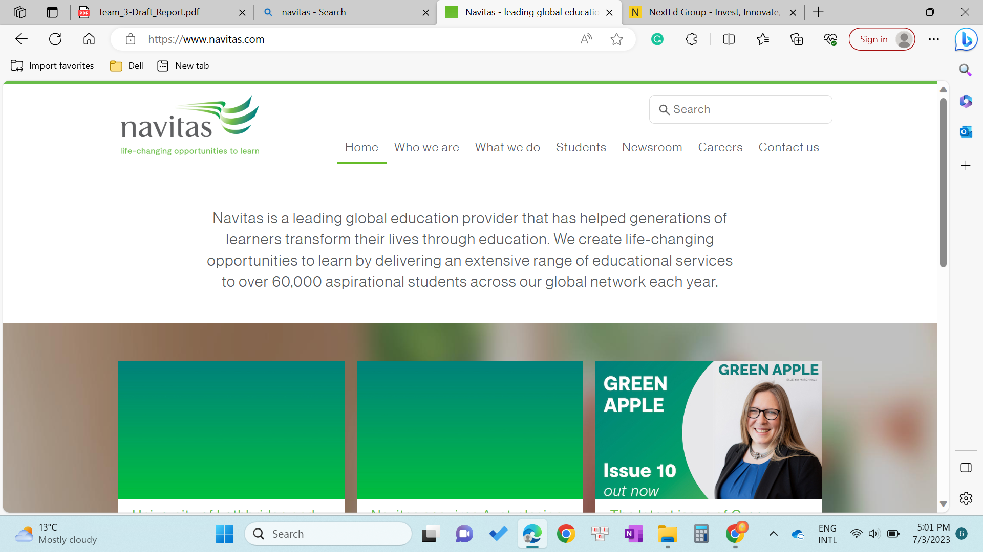
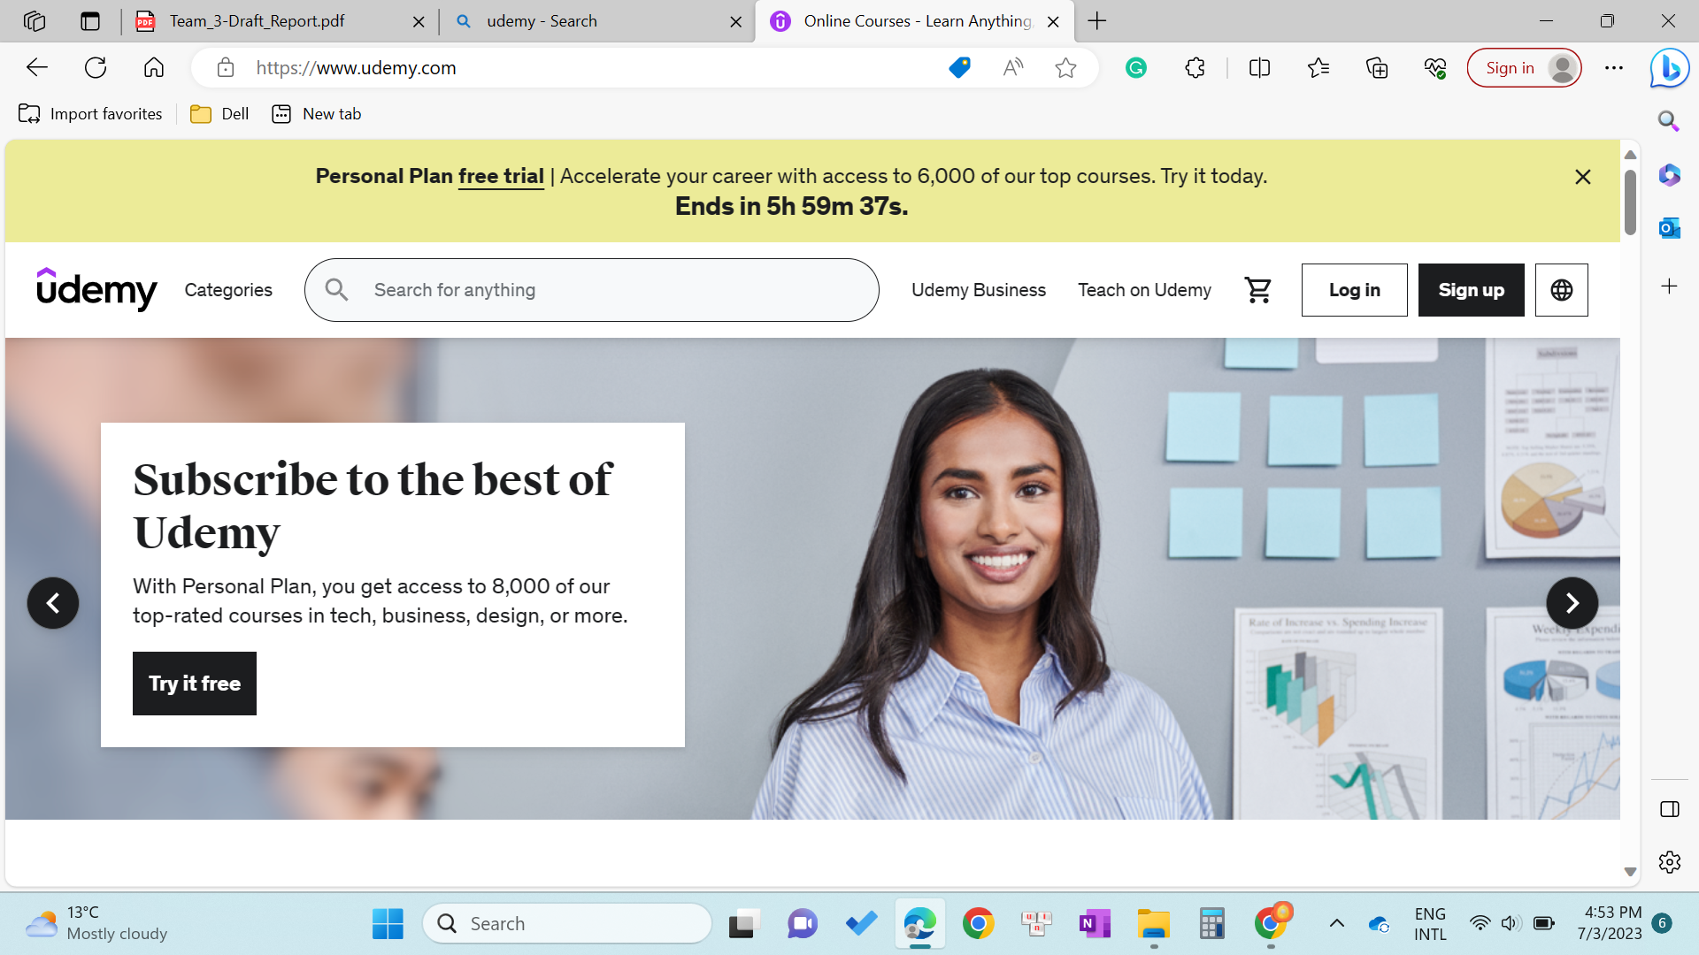
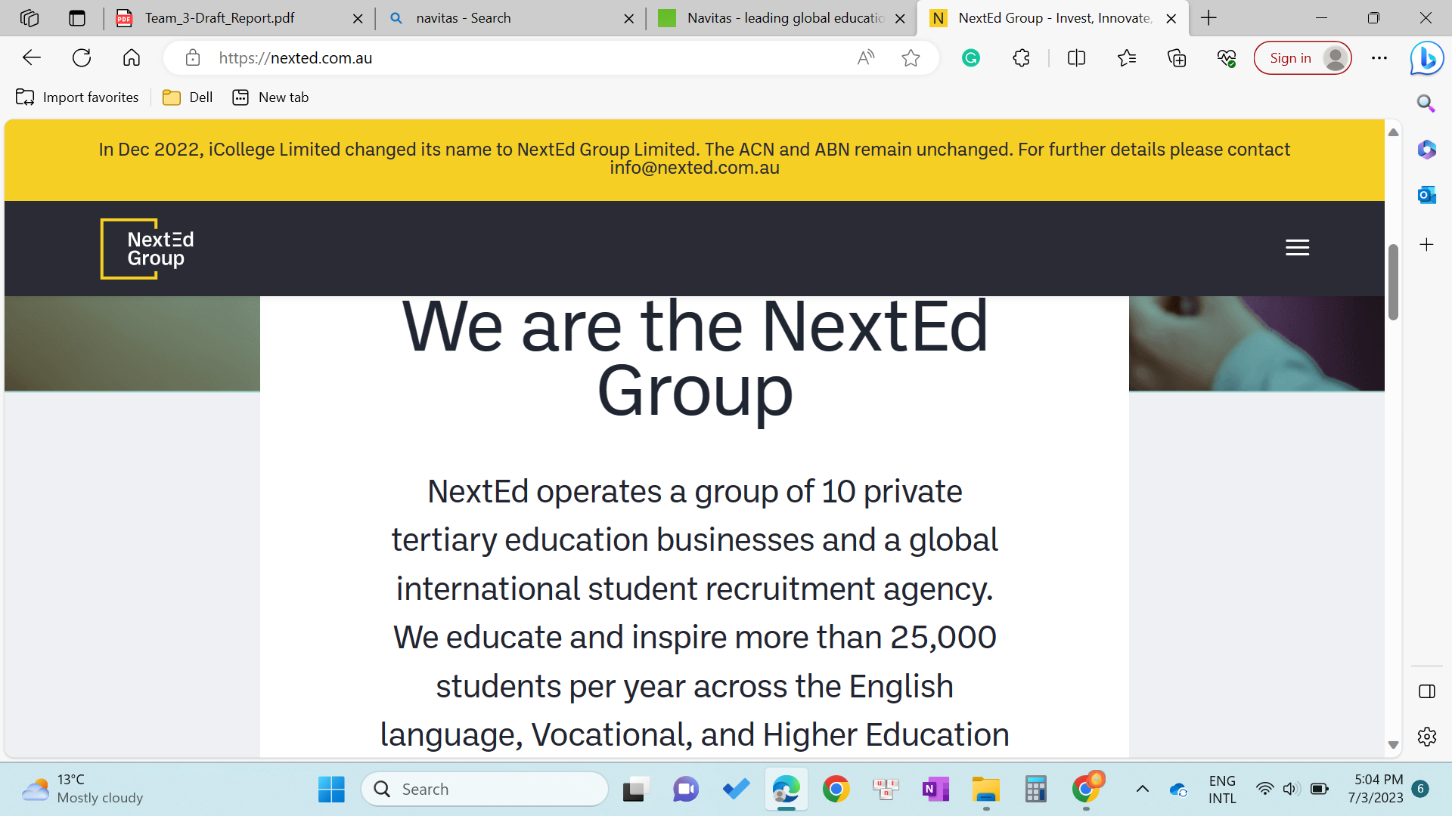
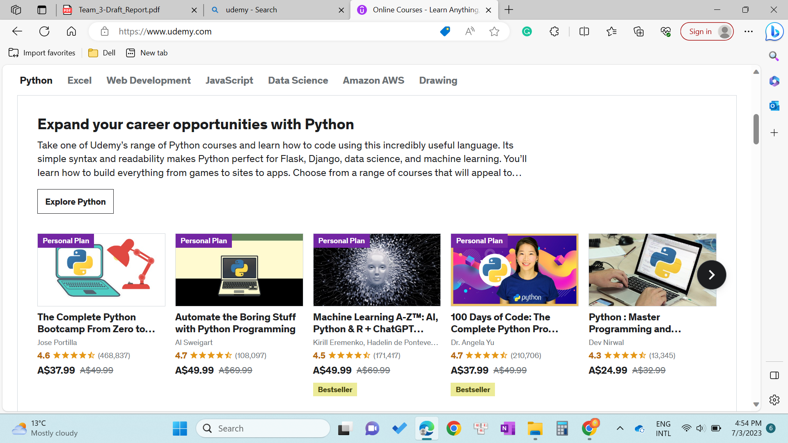
Competitor Analysis in Australia

Slide 9
SWOT analysis
STRENGTHS
Unique and different from other companies within the same industry in the Australia market.
Current asset: 3Hearts
Online operation platform
OPPORTUNITIES
International Coaching Federation: professional coaches worldwide increased from 53300 in 2012 to 71000 in 2019
=> growing demand for coaching services
Make more different: the use of AI – having a chatbot AI to help users experience the business more easily
WEAKNESSES
A start-up: Lack of sources and channels to reach out to coaches and clients.
THREATS
Cash-flow problems
Changing Consumer Preferences
Regulatory Risks: The International Coaching Federation has established ethical guidelines and certification requirements to regulate the coaching industry. Non-compliance with these regulations may lead to reputational damage and legal consequences for coaching service providers

Slide 10
Special Note
Despite distinguishing between customers and coaches in our research, we do not view them as entirely independent entities. They all belong to our target audience based on our interactions with Coachjable.
The differentiation exists to aid accurate profiling. In reality, these groups significantly overlap, as managers, who are typically viewed as customers, could also be potential coaches.
Both managers and entrepreneurs are our focus, not restricted to the 'customer' category.
The purpose of the differentiation is to aid in data understanding and to create universally applicable marketing strategies, aligning with Coachjable's goal of helping more people realise their dreams and overcome employment challenges.

Slide 11
Customer Analysis People in the Workforce and Related Marketing Strategies
​​Location
Gender
Age
Education Level

Slide 12
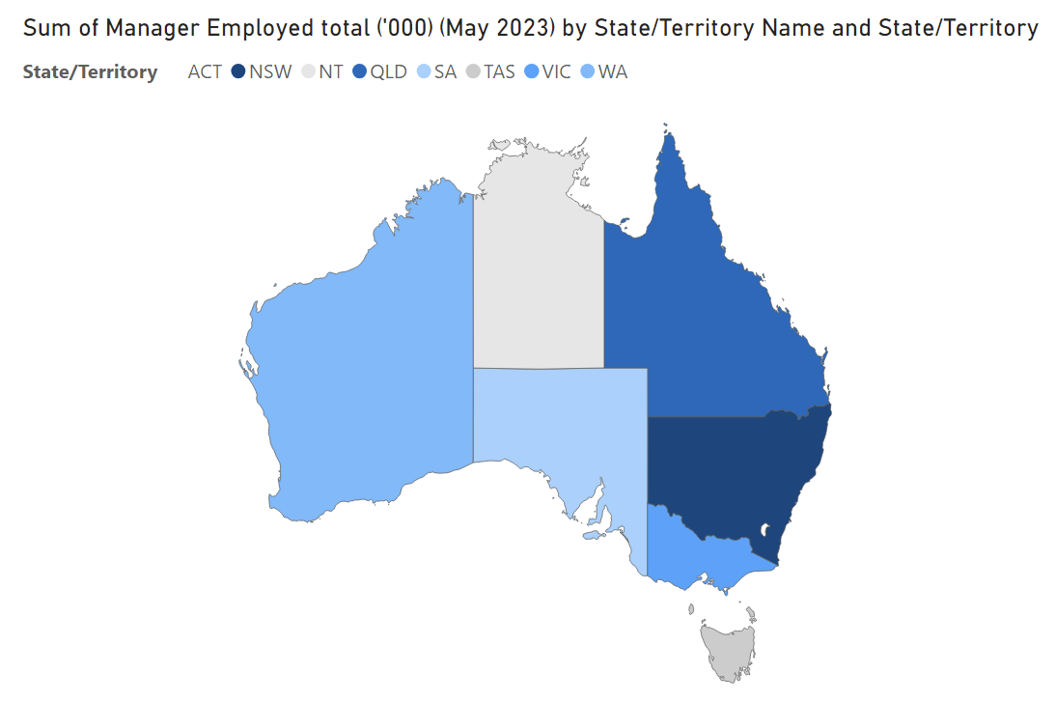
Location
​​Location：
The population is primarily concentrated in the following three areas: New South Wales, Victoria, and Queensland.
Marketing suggestion-Self-investment preferences and economic factors:
Coachjable should focus more on promotion and marketing in these areas;
Purchasing power and willingness to pay for self-improvement services;
Similar workers in the area means that there is more competitive pressure;
Rduce their anxiety, improve their 'mental health' and help with 'personal development' to increase their competitiveness.

Slide 13
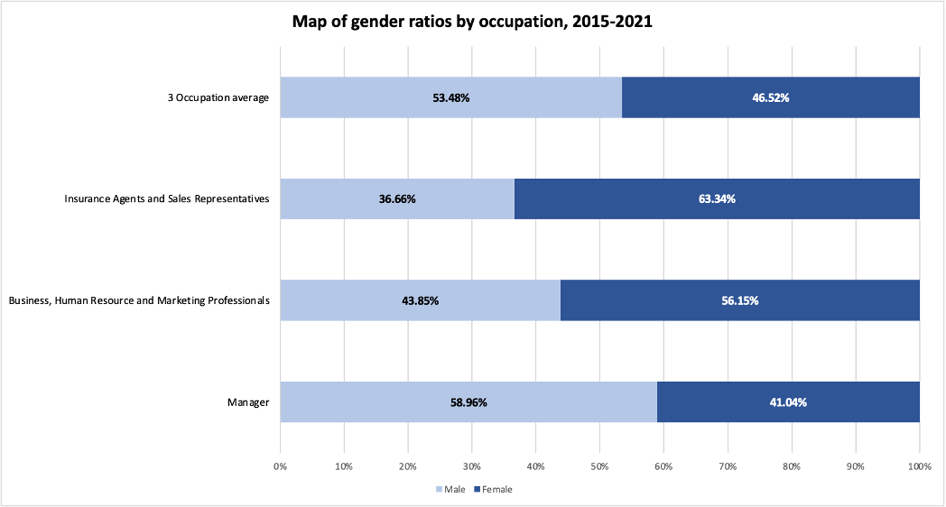
Gender
Marketing suggestion:
Product preferences: Men and women have different preferences of personal development.
Marketing messages: Different gender may respond better to different marketing messages.
Communication channels: Men and women may have different preferred communication channels.
Gender:
the target group has a roughly 6:4 ratio of men to women.

Slide 14
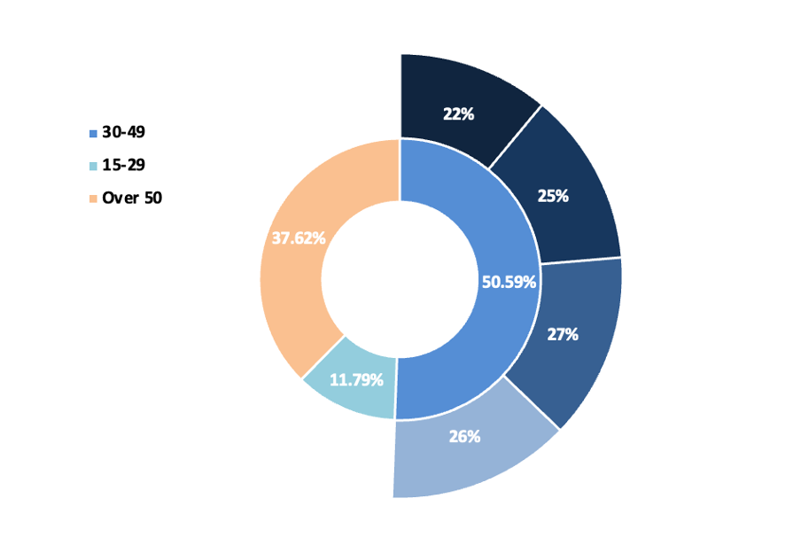
Age
Marketing suggestion:
Product preferences: Different age groups may have different preferences of self-improvement.
Marketing messages: The tone, language and content of marketing messages may need to be adapted to the age of your audience.
Communication channels: Different communication channels are used by different age groups.
Buying behaviour: This can influence Coachjable's marketing techniques, including the type of urgency and persuasiveness used in messaging.
Technology use: Younger people may prefer to use online or mobile-based self-improvement tools. Older people may prefer traditional methods.

Slide 15
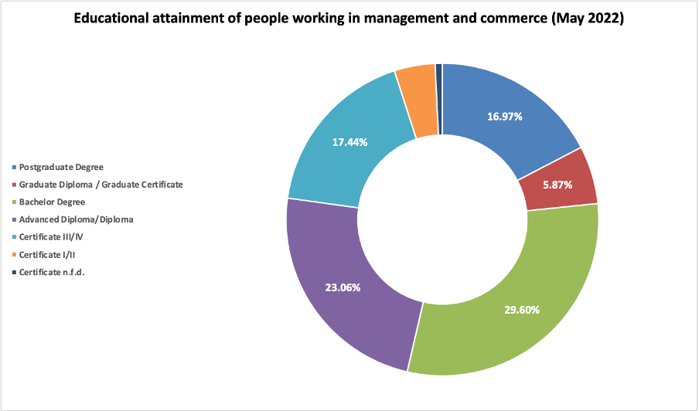
Education Level
Marketing suggestion:
Understanding and interpretation: Marketing message can be more detailed and complex
Purchasing power: Coachjable can target more premium or quality products to customers with higher levels of education.
Interests and needs: People with different educational backgrounds may have different interests and needs.
Preferred communication channels: Customers may prefer different communication channels.

Slide 16
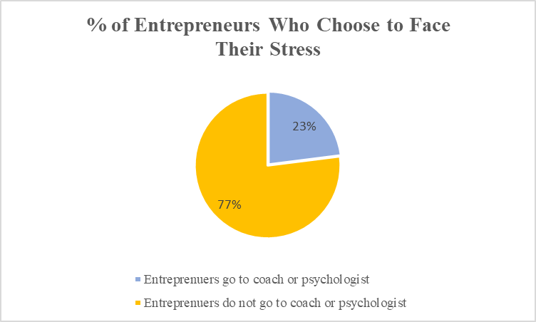
Entrepreneurs—How to attract entrepreneurs
Reasons why business owners avoid talking about their problems
Trust crisis: External skepticism and influence
Support issue: No expertise help them
Marketing suggestion:
Demonstrate the benefits of active problem solving in the advertising
Show an excellent service attitude at the first consultation
Sign a confidentiality agreement

Slide 17
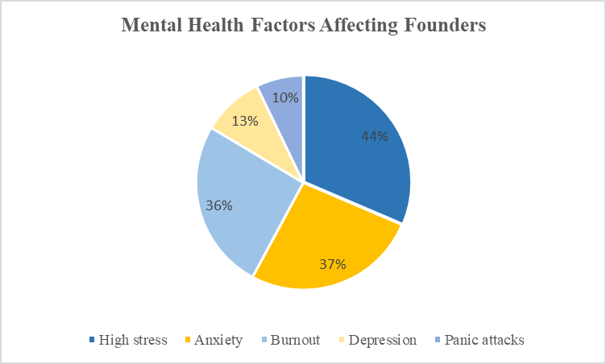
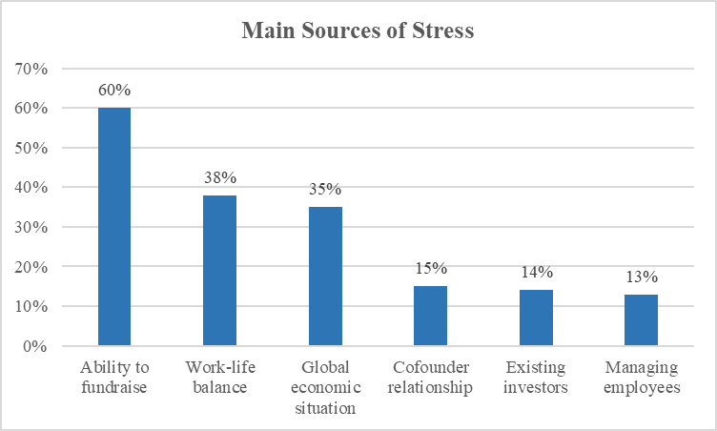
Courses Setting
Marketing suggestion:
Offer courses that are related these topics as well as a detailed diet, exercise and exercise plan for these business persons.
Provide bundle service together with 3heart to provide a more holistic product content

Slide 18
Coach analysis
Coach base analysis
Coach source analysis

Slide 19
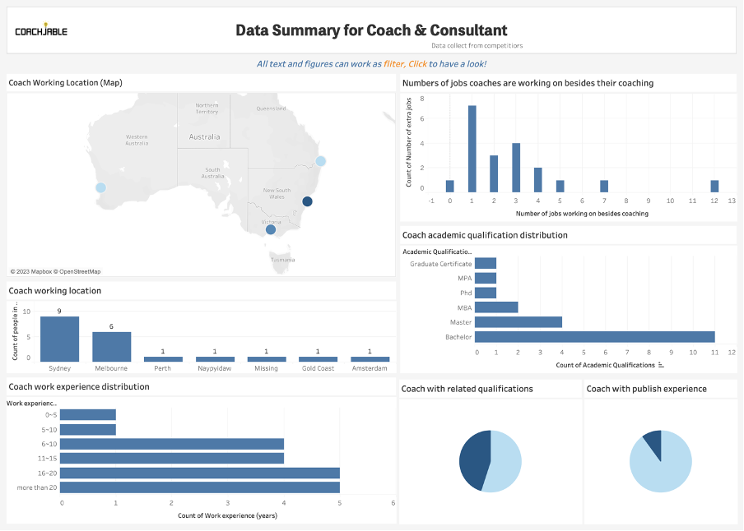
Coach base analysis
Working on several jobs is a norm
Located in Sydney & Melbourne
Most have at least a Bachelor degree
Most have more than 10 years working experience
Some have relevant qualifications and publish experience

Slide 20
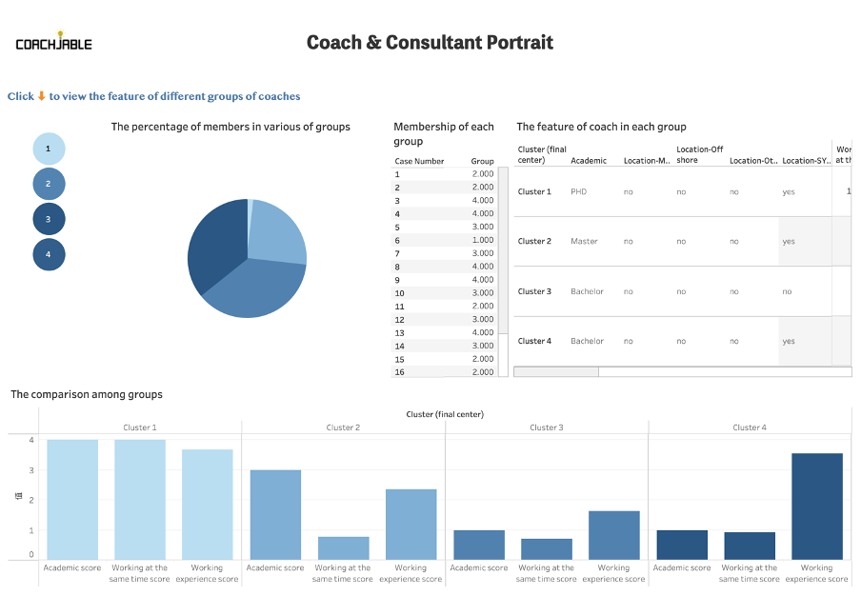
Coach base analysis
Buttons used to filter each group
Table list members within each group
Table shows detailed features of each group
Most common coaches:
Group 2: Highly educated and experienced professionals
Group 3: Younger coaches with undergraduate degrees and moderate work experience

Slide 21
Coach analysis - Health
​​Industry Profile
Health Coach Analysis
Suggestion

Slide 22
The Industry Profile
The overview of the industry
Employed | 2,112,600
Past growth | 25.8%
Future growth | 15.8%
Weekly earnings | $1150
Workforce share | 15.3%
Full-time share | 56.9%
Average age | 41
A clear increasing trend of employed people in the industry
A lower-than-average weekly earning

Slide 23
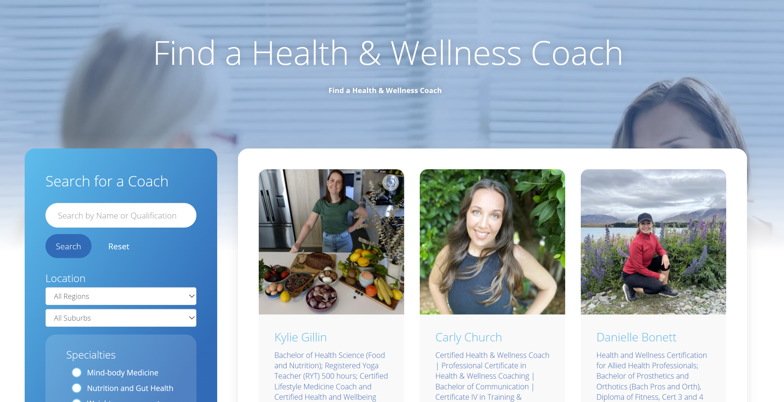

The Health Coach Analysis - HCANZA

Slide 24
The Health Coach Analysis – Education & Certificate
Most People have relevant Education backgrounds.
Certificates are more essential in the industry.

Slide 25
The Health Coach Analysis – Specialties & Location
HCANZA provides each coach’s specialties.
The majority of coaches are concentrated in NSW, QLD, and VIC.

Slide 26
Suggestion
Provide an above-average income.
Cooperate with health coach associations.
Select coaches based on educational background and specialisation.
Location can be used as a reference when marketing.

